Slide 1


Revolutionizing Public Transportation: The Smart Bus System
The Smart Bus system offers an efficient, convenient, and secure transportation experience. Using RFID technology, it automates ticketing and reduces fraud risk.
vv

Slide 2

SMART BUS OPTIMIZING PUBLIC TRANSPORT
Loading...
IBM Naan Mudhalvan-Group2 Internet Of Things(IOT)
Kingston Engineering college
College code-5113
By
S. pavithra - naan mudalvan ID:au511321106019 , Email: pavithrasundervadivel04@gmail.com
R .Vijaya bharathi - naan mudalvan ID:au511321106026 ,Email:Vijayabharathi152003@gmail.com
T. Madhu mitha - naan mudalvan ID: autle-06ece , Email: madhumithausha2002@gmail.com
S.Vaideeswari - naan mudalvan ID: autle-01ece, Email:vaishusaravanan1315@gmail.com
S.Priya Dharshini - Naan mudalavan Id : autle-05ece,Email: priyadharshinis07092000@gmail.com

Slide 3
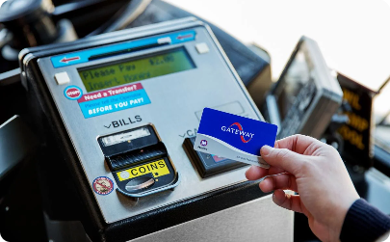
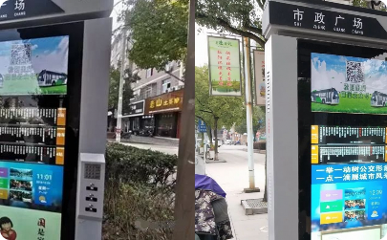
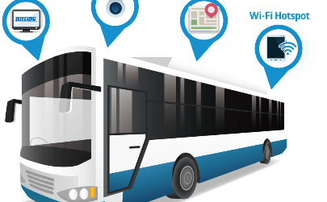
Enhancing the Passenger Experience
Seamless Ticketing
Real-time Updates
Onboard Connectivity
Passengers can simply tap their smart bus cards for contactless payment, eliminating the need for cash or physical tickets.
The LCD display inside the bus provides real-time information on bus timings, route updates, and upcoming stops, enhancing the passenger experience.
Passengers can stay connected with onboard WiFi, allowing them to work, browse the internet, or stream their favorite content during the commute.

Slide 4
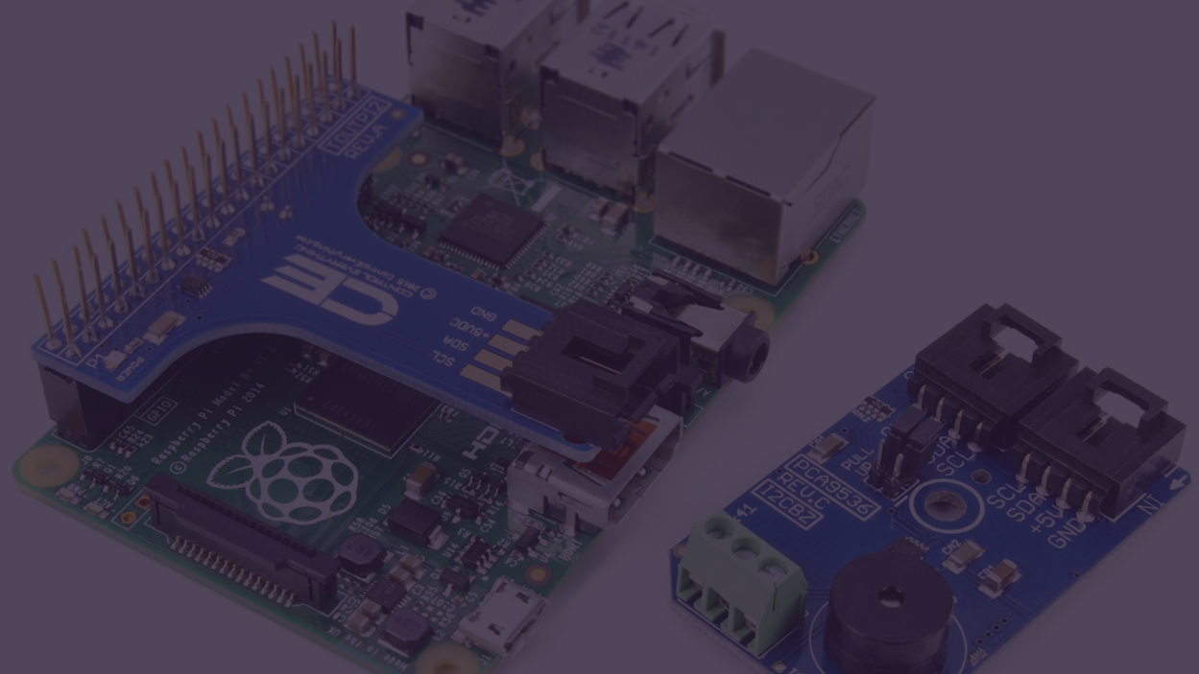
Transportation cards will use IoT-based devices for contactless ticketing and payment, allowing for a safer and more convenient experience for passengers.

Slide 5

The Power of RFID Technology
1
Streamlined Operations
2
Secure and Reliable
RFID technology enables quick and accurate ticketing, reducing boarding time and allowing buses to adhere to schedules more efficiently.
RFID cards provide secure access control, minimizing the risk of ticket fraud and ensuring that only verified passengers can utilize the smart bus system.
3
Data-driven Insights
RFID data can be analyzed to identify passenger trends, optimize routes, and make data-driven decisions to enhance the overall effectiveness of the public transportation system.

Slide 6
Components of the Smart Bus System
RFID Reader
Servo Motors
Bus Stop Switch
Arduino Nano
The RFID reader scans the smart bus cards, extracting data for ticket validation and passenger information.
Servo motors control the opening and closing of the bus doors, ensuring a smooth and safe boarding experience for passengers.
The Arduino Nano is the brain of the smart bus system, processing data and controlling various components to provide a seamless transportation experience.
The bus stop switch triggers the LCD display to show upcoming stops and relevant information for passengers.

Slide 7
Automating Ticketing with Precision
1
Step 1: Tap Smart Card
Passengers tap their smart bus cards on the RFID reader to initiate the ticketing process.
Step 2: Data Validation
2
The RFID reader validates the card data, ensuring its authenticity and confirming the passenger's eligibility for the journey.
3
Step 3: Fare Deduction
The fare amount is automatically deducted from the passenger's card, allowing for a seamless payment process.

Slide 8
Reducing Fraud Risk
Stricter Authentication
Only valid smart bus cards can be used, preventing counterfeit, expired, or tampered cards.
Real-time Monitoring
The system detects any suspicious activities or anomalies, enabling prompt action to mitigate fraud risks.
Transaction Logging
Every ticketing transaction is logged, providing valuable data for auditing and investigation purposes if any fraudulent activities are suspected.

Slide 9
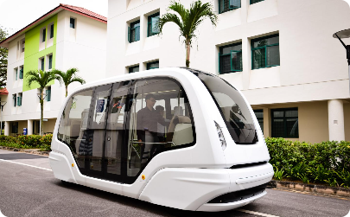
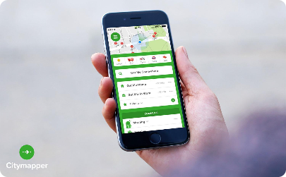
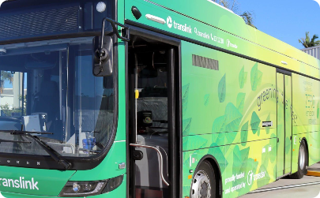
Future Innovations on the Horizon
Autonomous Vehicles
Integrated Mobile Apps
Renewable Energy Adoption
Imagine smart buses operating autonomously, with advanced AI technology ensuring safe, efficient, and eco-friendly transportation.
Future advancements may include smart bus apps that offer real-time bus tracking, personalized route suggestions, and enhanced ticketing capabilities.
Smart buses powered by renewable energy sources can contribute to reducing carbon emissions and building a sustainable public transportation network.

Slide 10
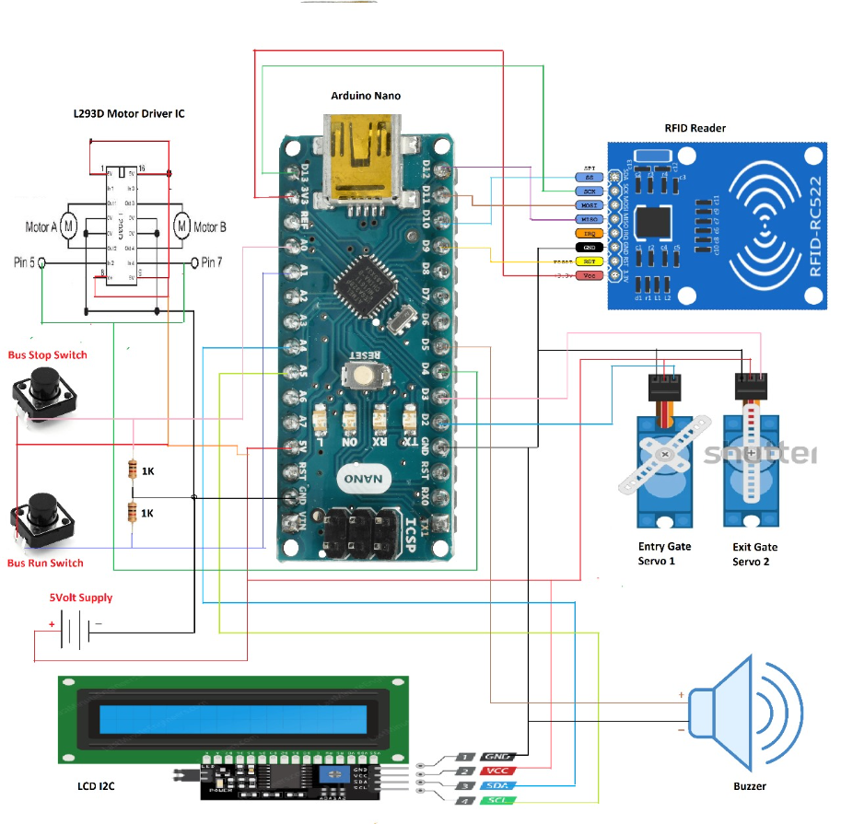
CIRCUIT DIAGRAM

Slide 11
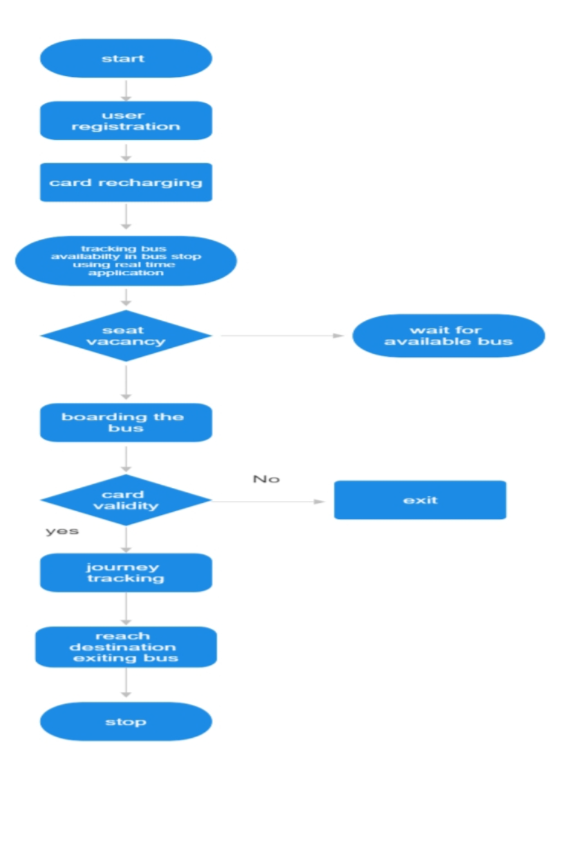
FLOW CHART

Slide 12
User Procedure:
User approaches the smart bus stop and waits for the bus to arrive. As the bus arrives, the user taps their RFID-based smart card on the reader located near the entrance door of the bus. The RFID reader scans the card and checks for its validity and balance. If the card is valid and has sufficient balance, the reader deducts the fare amount from the card and displays a confirmation message. The user proceeds to board the bus. Inside the bus, the user finds a seat they wish to occupy. The user opens a real-time app on their smartphone, which shows the seat availability on the bus. The user selects their desired seat from the app and confirms the selection. The app sends a request to the bus's GPS tracking system to check the availability of the selected seat. The GPS tracking system receives the request and verifies the seat availability. If the seat is available, the app displays a confirmation message to the user, and they occupy the seat. If the seat is not available, the app notifies the user and allows them to select an alternative seat if desired. Throughout the bus ride, the app continuously updates the user about the current location of the bus and estimated arrival time to the destination. When the user approaches their destination, they get notified by the app so they can prepare to alight. Upon reaching the destination, the user taps their smart card on the reader near the exit door to complete the payment transaction and exit the bus. Flow Chart:
User arrives at the smart bus stop. User taps their RFID-based smart card on the entrance reader of the bus. RFID reader checks the card validity and balance. If valid and sufficient balance, the fare amount is deducted and confirmation is displayed. User boards the bus. User opens the real-time app on their smartphone. App displays seat availability. User selects desired seat and confirms. App sends a request to the GPS tracking system to check seat availability. GPS tracking system verifies seat availability. If seat available, app displays confirmation and user occupies the seat. If seat not available, app notifies user and allows selection of an alternative seat. App continuously updates user about bus location and estimated arrival time. User gets notified when approaching destination. User taps smart card on exit reader to complete payment and exit the bus. End.

Slide 13
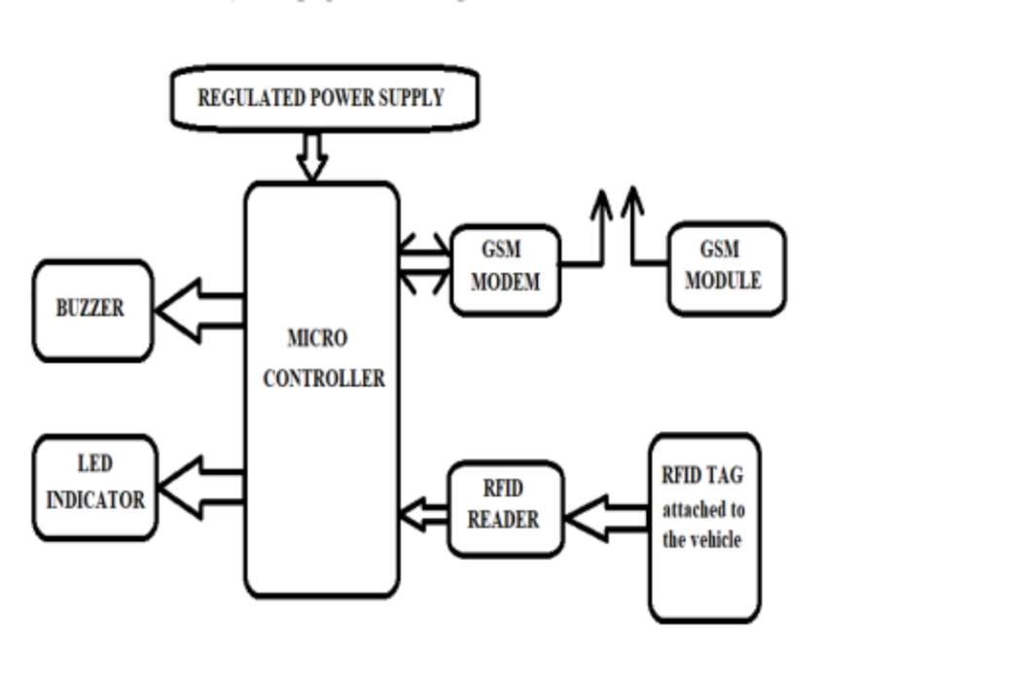
system architecture

Slide 14
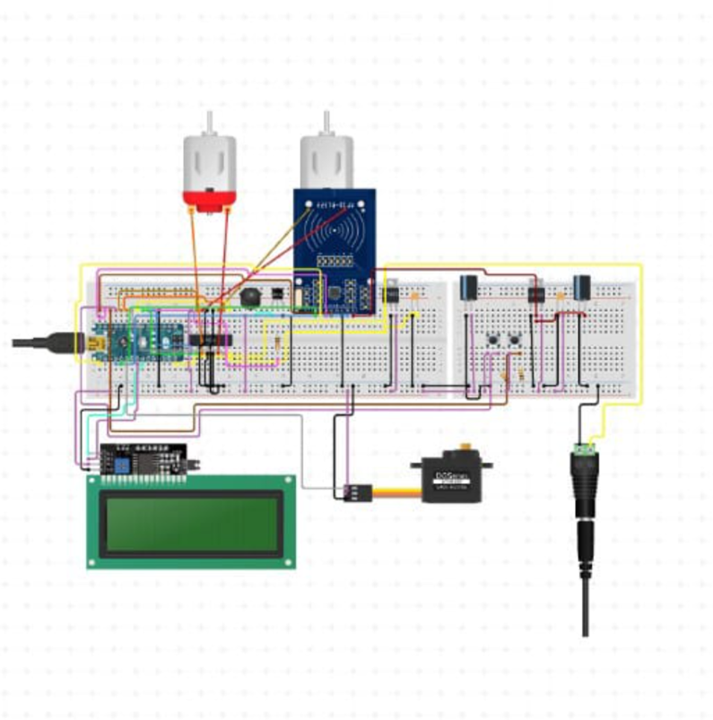
circuit diagram

Slide 15
SOURCE CODE
//include the RFID libs
#include <SPI.h>
#include <MFRC522.h>
//include the LCD lib
#include <LiquidCrystal.h>
//declear the reset and SDA pins of RFID
#define SS_PIN 10
#define RST_PIN 9
// Create MFRC522 instance.
MFRC522 mfrc522(SS_PIN, RST_PIN); // Create MFRC522 instance.
//declear what LCD pins u are sending data
LiquidCrystal lcd(3, 2, 6, 4, 7, 5);
tring pass1 = "CHIBUEZE";
String acct1 = "6A 2D 67 07";
String pass2 = "SMART";
String acct2 = "77 1F 73 63";
int balance1 = 1000;
int balance2 = 1000;
int rate = 200;
void setup()
{
Serial.begin(9600);
// Initiate SPI bus

Slide 16
SPI.begin();
// Initiate MFRC522
mfrc522.PCD_Init();
//begin the LCD
lcd.begin(16, 4);
//state your actuator pins
pinMode(A0, OUTPUT);
pinMode(A1, OUTPUT);
pinMode(A2, OUTPUT);
//display a welcome note
lcd.setCursor(0, 0);
lcd.print("WELCOME CHIBUEZE ");
delay(4000);
lcd.setCursor(0, 0);
lcd.print(" BUS TICKET ");
lcd.setCursor(0, 1);
lcd.print(" PAYMENT SYSTEM ");
delay(2000);
lcd.clear();
//mfrc522.PCD_Init(); // Init MFRC522
lcd.setCursor(0, 2);
lcd.print(" ");
lcd.setCursor(0, 3);
lcd.print(" ");
}
void unregisted(){
tone(A0, 1000);
delay(500);
noTone(A0);

Slide 17
delay(500);
tone(A0, 1000);
delay(500);
noTone(A0);
delay(500);
tone(A0, 1000);
delay(500);
noTone(A0);
delay(500);
lcd.setCursor(0, 0);
lcd.print(" UNREGISTERED ");
delay(2000);
lcd.setCursor(0, 1);
lcd.print("PLS GET A VALID CARD");
for (int positionCounter = 0; positionCounter < 43; positionCounter++) {
// scroll one position left:
lcd.scrollDisplayLeft();
// wait a bit:
delay(150);
}
//lcd.clear();
}
void loop() {
//turn off the actuators
digitalWrite(A0, LOW);
analogWrite(A1, 0);
analogWrite(A2, 0);
lcd.setCursor(0, 0);
lcd.print("Bus Fare is #");

Slide 18
lcd.println(rate);
lcd.println(" ");
lcd.setCursor(0, 1);
lcd.print(" Swipe To Pay ");
// Look for new cards
if ( ! mfrc522.PICC_IsNewCardPresent())
{
return;
}
// Select one of the cards
if ( ! mfrc522.PICC_ReadCardSerial())
{
return;
}
//Show UID on serial monitor
Serial.print("UID tag :");
String content= "";
byte letter;
for (byte i = 0; i < mfrc522.uid.size; i++)
{
Serial.print(mfrc522.uid.uidByte[i] < 0x10 ? " 0" : " ");
Serial.print(mfrc522.uid.uidByte[i], HEX);
content.concat(String(mfrc522.uid.uidByte[i] < 0x10 ? " 0" : " "));
content.concat(String(mfrc522.uid.uidByte[i], HEX));
}
Serial.println();
Serial.print("Message : ");
content.toUpperCase();
//this is where u put the UID of the card that you want to give access

Slide 19
if (content.substring(1) == "6A 2D 67 07") {
analogWrite(A2, 255);
delay(250);
analogWrite(A2, 0);
delay(250);
analogWrite(A2, 255);
if (balance1 >= rate){
balance1 -= rate;
lcd.setCursor(0, 0);
lcd.print(" Hi CHIBUEZE ");
lcd.setCursor(0, 1);
lcd.print("__Payment O.K__ ");
}
else{
lcd.setCursor(0, 0);
lcd.print(" Sorry CHIBUEZE ");
lcd.setCursor(0, 1);
lcd.print("Insuficient Fund");
}
delay(4000);
lcd.setCursor(0, 1);
lcd.print("_Balance is #");
lcd.println(balance1);
lcd.println(". .");
delay(4000);
return;
}
if (content.substring(1) == "77 1F 73 63") {
analogWrite(A2, 255);

Slide 20
delay(250);
analogWrite(A2, 0);
delay(250);
analogWrite(A2, 255);
if (balance2 >= rate){
balance2 -= rate;
lcd.setCursor(0, 0);
lcd.print(" Hi SMART ");
lcd.setCursor(0, 1);
lcd.print("__Payment O.K__ ");
}
else{
lcd.setCursor(0, 0);
lcd.print(" Sorry SMART ");
lcd.setCursor(0, 1);
lcd.print("Insuficient Fund");
}
delay(4000);
lcd.setCursor(0, 1);
lcd.print("_Balance is #");
lcd.println(balance2);
lcd.println(". .");
delay(4000);
return;
}
}

Slide 21
else{
lcd.clear();
analogWrite(A1, 255);
delay(250);
analogWrite(A1, 0);
delay(250);
analogWrite(A1, 255);
unregisted();
}
lcd.clear();
}

